Slide 1
Thai National Telescope ZEMAX file clarifications
C.Buisset – NARIT
22th August 2013

Slide 2
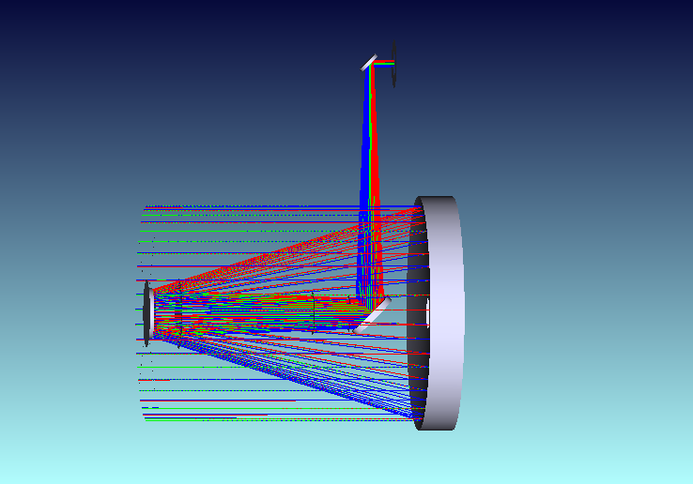
TNT ZEMAX file
File name: TNT_2.4m_as_built_telescope_20130820
→ Comprise the optical surfaces from telescope entrance (spider) to cube output
M4
Cube output
M1
M2
M3

Slide 3
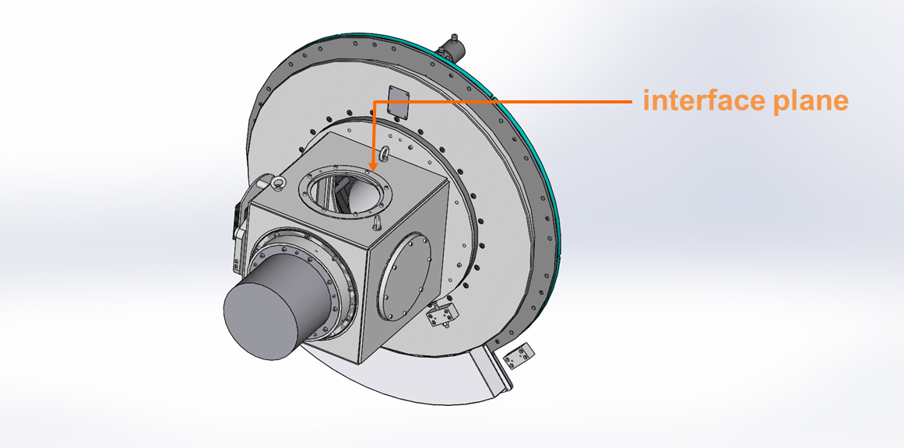
TNT ZEMAX file
ULTRASPEC interface plane
ULTRASPEC is mounted on one flange located on one of the Insturment cube output → Defines the optical and mechanical interface plane

Slide 4
TNT ZEMAX file
ULTRASPEC interface plane
The interface plane is the ZEMAX Surface 30 « Cube Output »
This optical surface is located at 250 mm from M4 apex for all instrument cube output ports.
Cube output = interface plane

Slide 5
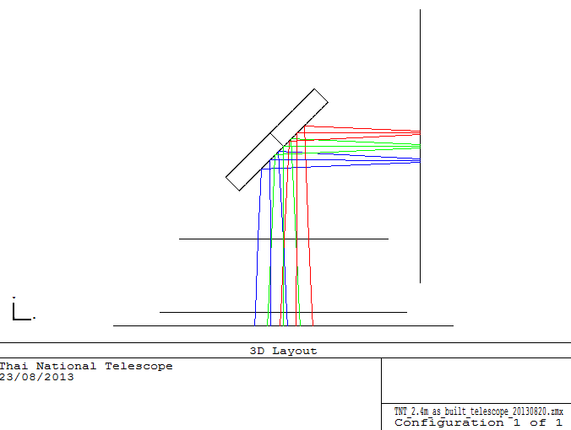
TNT ZEMAX file
ULTRASPEC interface plane
The mounting flange plane is the ZEMAX Surface 30 « Cube Output »
Cube output =
interface plane
M4
Spacer

Slide 6
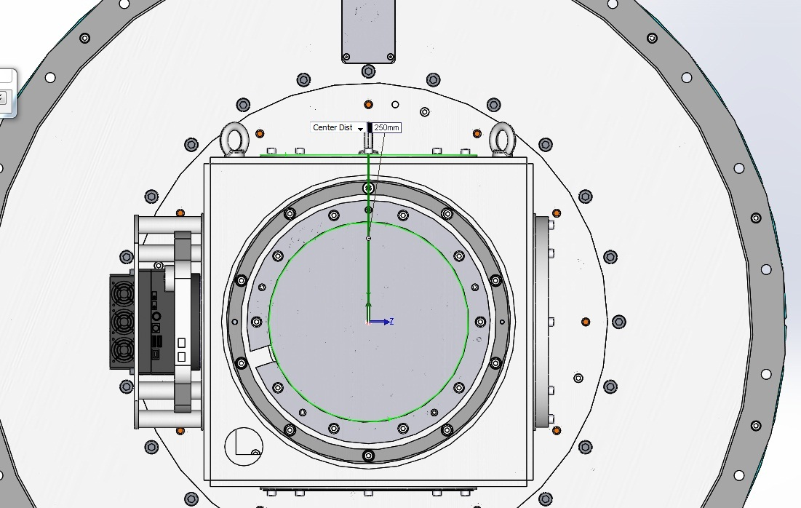
TNT ZEMAX file
ULTRASPEC interface plane
→ We have verified that the distance between the interface plane and the M4 centre is equal to 250 mm (full agreement with ZEMAX model)

Slide 7
TNT ZEMAX file
ULTRASPEC interface plane
→ We have verified that the distance between the interface plane and the M4 centre is equal to 250 mm (full agreement with ZEMAX model)
Distance interface plane – M4 centre

Slide 8
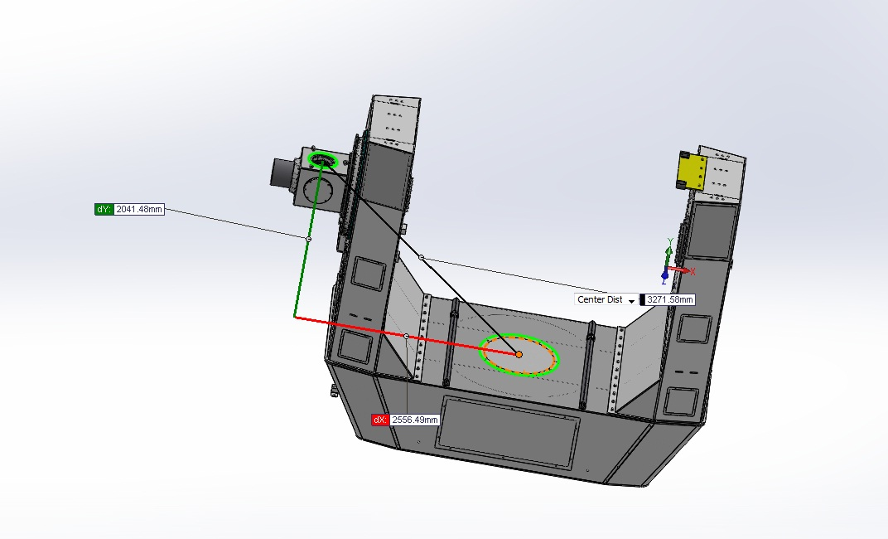
TNT ZEMAX file
ULTRASPEC interface plane
The mechanical distance between the M4 centre and the M1 Apex is
d = 2556.49 mm (measured on TNT CAD model – dx distance)

Slide 9
TNT ZEMAX file
ULTRASPEC interface plane
The distance measured d between M4 and M1 apexes is assessed by using
« Prescription data » → « Global Vertex » with M1 as the « Global reference Coodinate »
The ZEMAX distance between M4 and M1 apexes is d = 2556.66 mm
The ZEMAX and the mechanical models are in good agreement (discrepency δ ≈ 200 µm, not critical for current application)

Slide 10
TNT ZEMAX file - Conclusions
The ZEMAX file provided is representative of the TNT opto-mechanical design
The « Output cube » ZEMAX surface represents the Ultraspec mounting flange plane located at 250 mm from M4 apex
The « M4– M1 » apexes distance is d = 2556.6 mm +/- 0.1 mm

